Slide 1
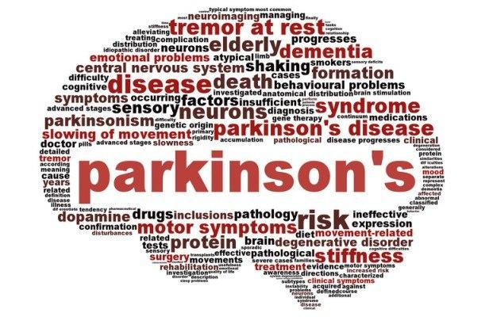
180030326 – T. N. S. Rama Charan
180030346 – N. Naga Teja
180030358 – K. Harshith

Slide 2
Q). Parkinson disease prediction using Gait dataset
Aim:-Parkinson disease prediction using Gait dataset

Slide 3
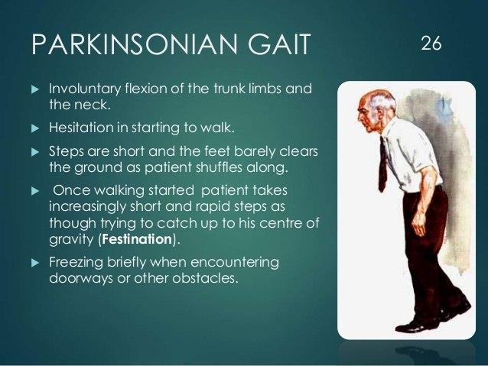

Slide 4
About disease and symptoms
Parkinson's disease (PD), or simply Parkinson's is a long-term degenerative disorder of the central nervous system that mainly affects the motor system. The symptoms usually emerge slowly and, as the disease worsens, non-motor symptoms become more common.
The most obvious early symptoms are tremor, rigidity, slowness of movement, and difficulty with walking, but cognitive and behavioral problems may also occur.

Slide 5
Steps involved:-
Dataset Selection
Identifying the libraries
Preprocessing the Data
Splitting the data
Object Creation
Fitting the data
Getting Accuracy

Slide 6
Dataset reference:-https://www.kaggle.com/dipayanbiswas/parkinsons-disease-speech-signal-features
Algorithm used:-
Decision Tree,Random Forest Classifier

Slide 7
Decision Tree:-
A decision tree is a decision support tool that uses a tree-like model of decisions and their possible consequences, including chance event outcomes, resource costs, and utility. It is one way to display an algorithm that only contains conditional control statements.

Slide 8
Random Forest Classifier:-
Random forests or random decision forests are an ensemble learning method for classification, regression and other tasks that operate by constructing a multitude of decision trees at training time and outputting the class that is the mode of the classes or mean/average prediction of the individual trees.

Slide 9
Thank You

